Slide 1
Bypass Big Data on the Bloomington Byway
Doc & Joyce Searls

Slide 2
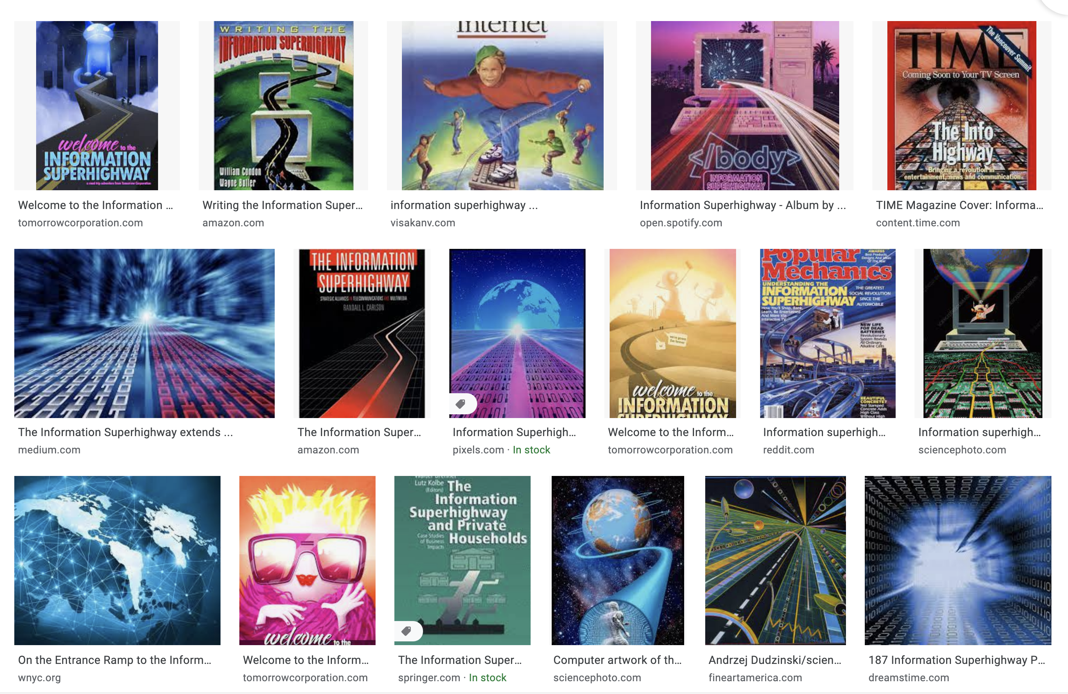
This was the promise of the Internet in 1995:

Slide 3
This is where we are in 2021:

Slide 4
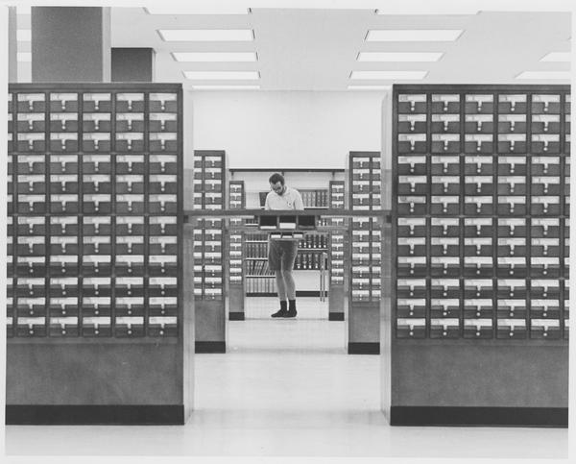
On the Internet, this is how the Web looked. At first.
http://location.type/folder/folder/folder/file

Slide 5
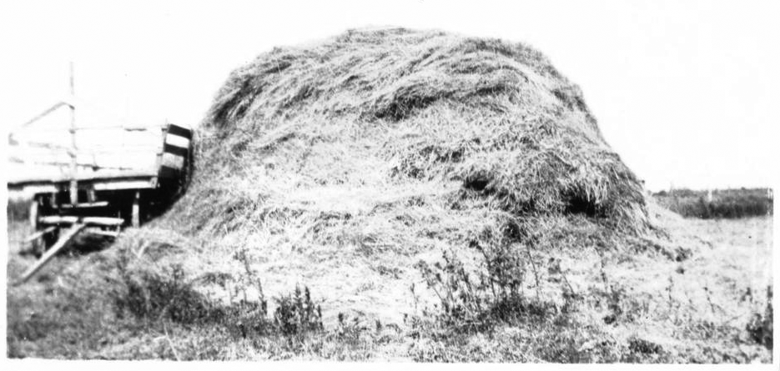
But this is what the Web quickly became.

Slide 6
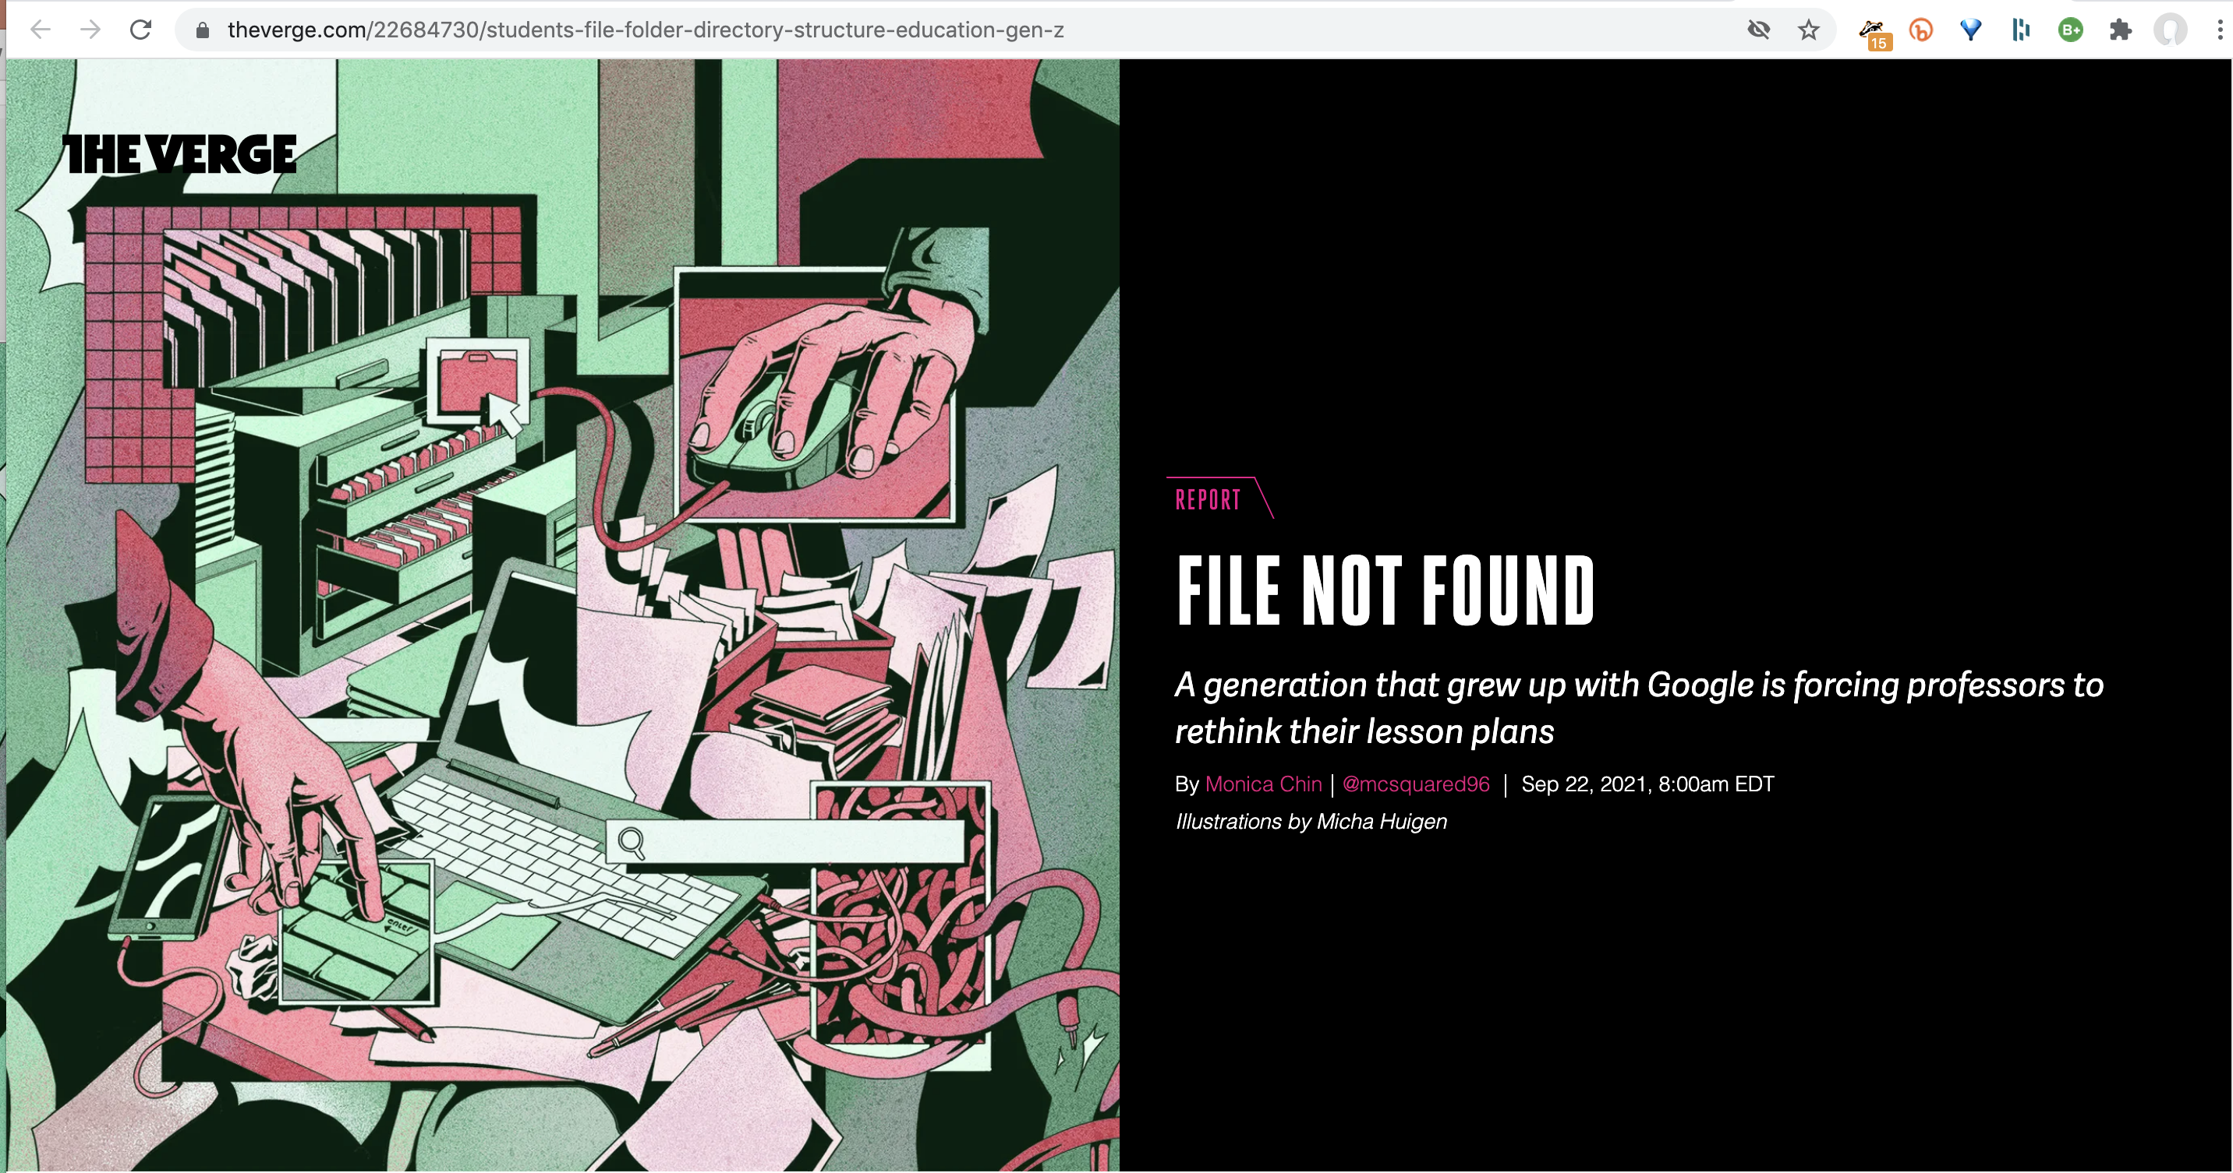
And so did our computers.

Slide 7
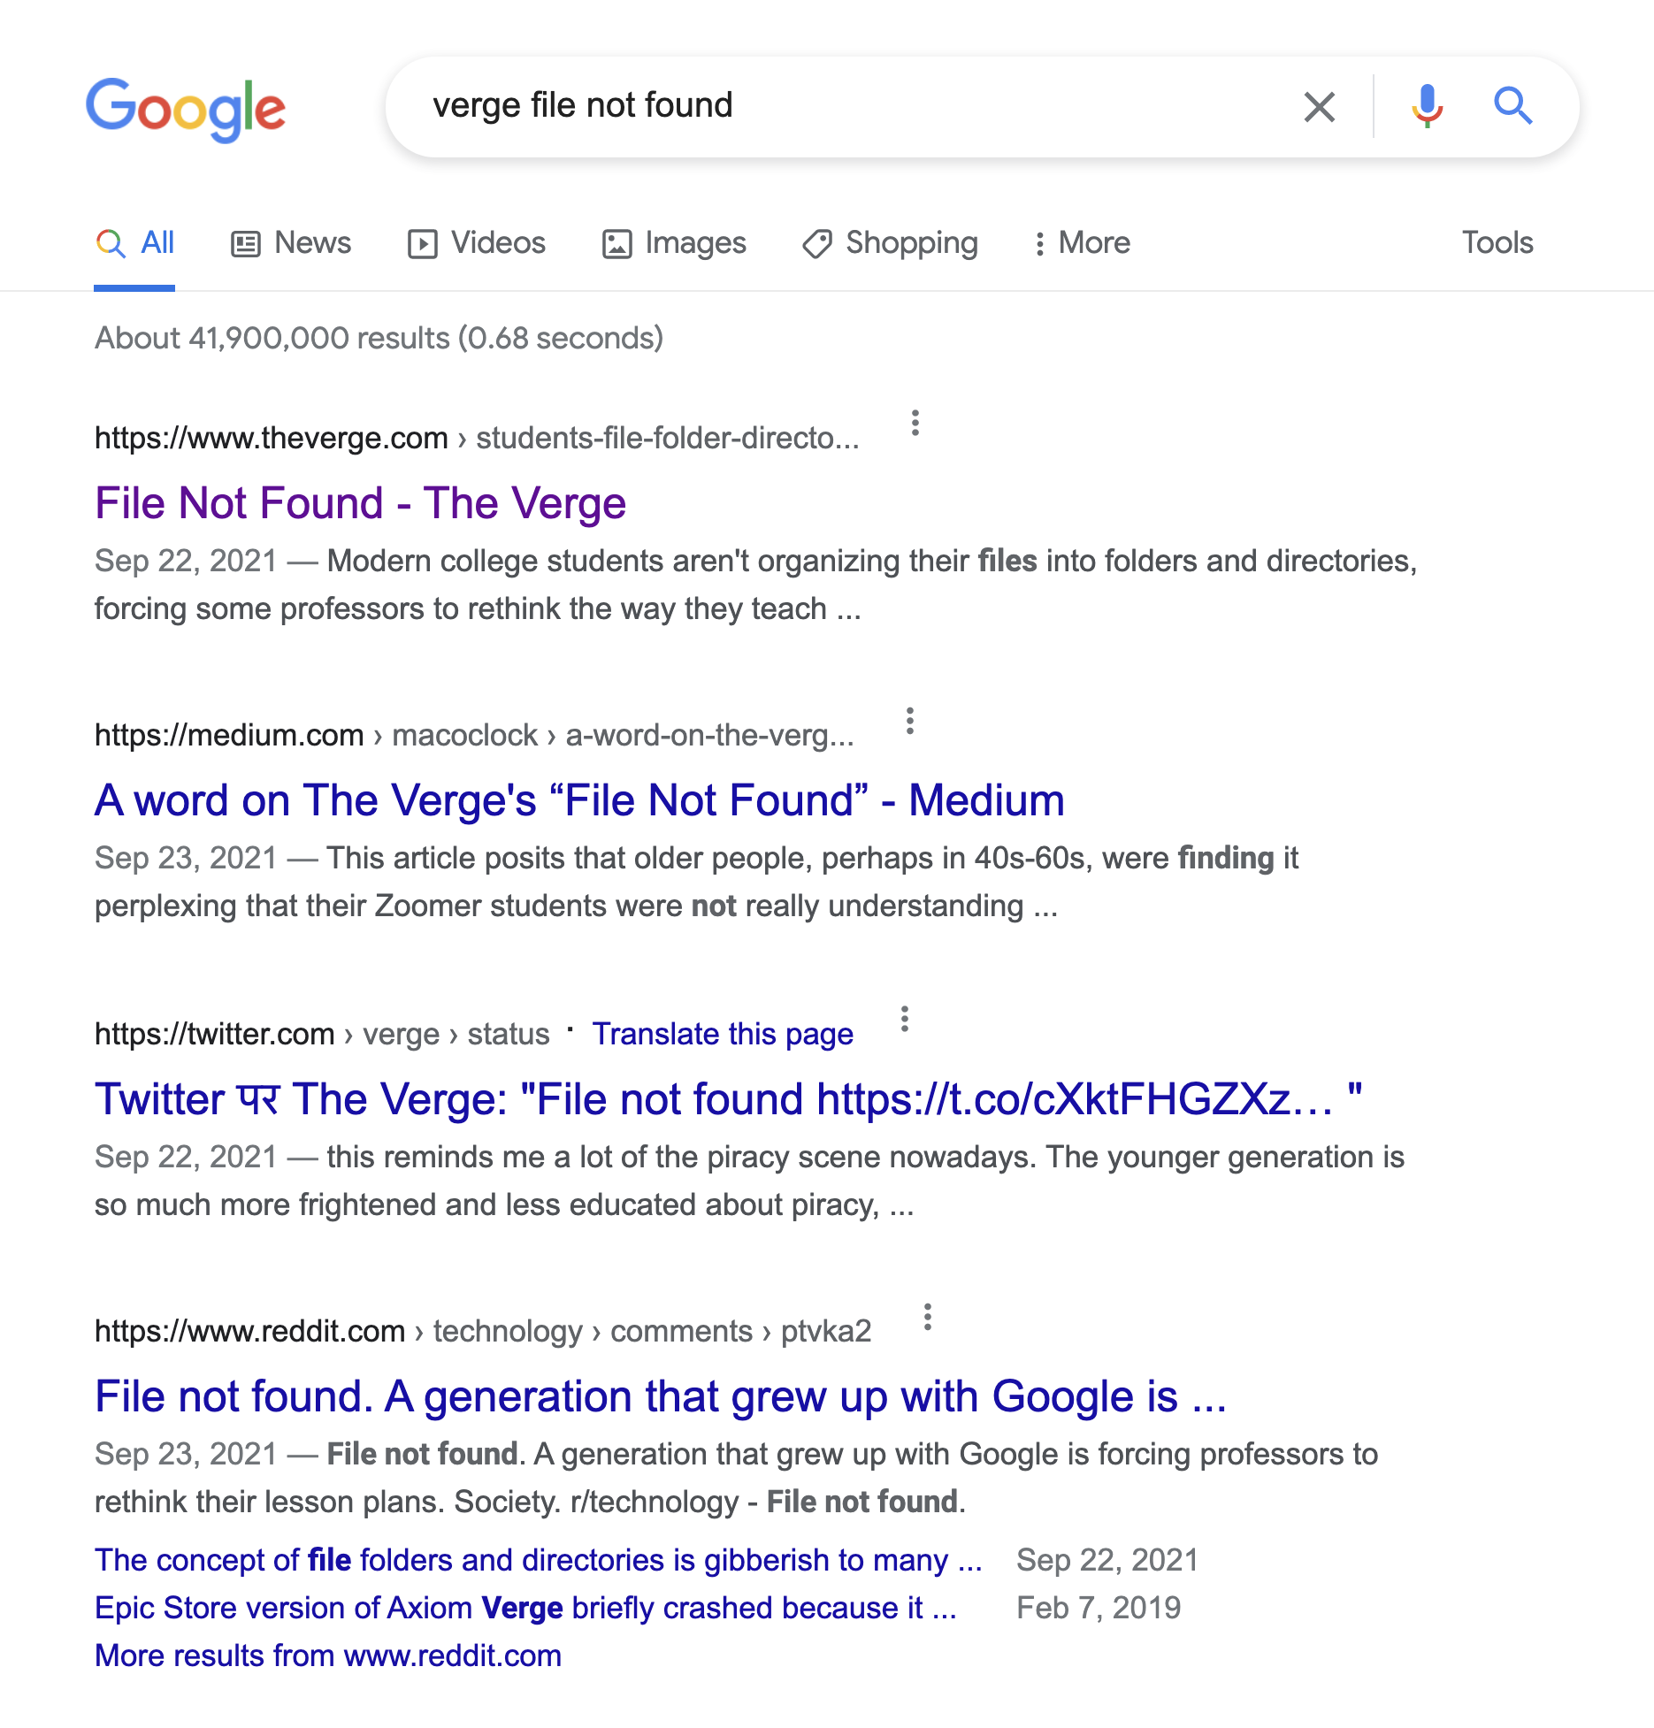
Why bother with a directory when a search finds more?

Slide 8
There is a lot you still can’t do with the Web and Big Tech
Have your own home
Have your own terms and policies
Control your identity
Express loyalty in your own ways
Run your own algorithms, on your own data
Have your own shopping cart
Have a dashboard for your life online
So, time for a road trip

Slide 10
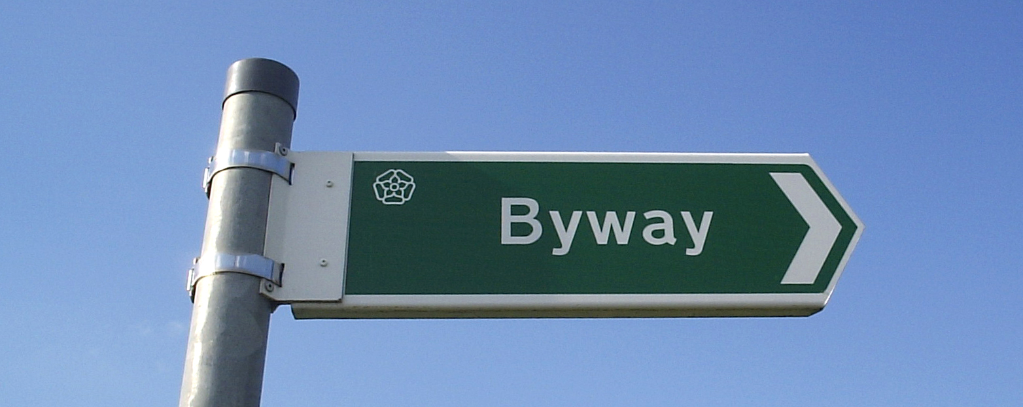
The Byway is the Net’s free and open marketplace
A platform-free way
to connect demand and supply

Slide 11
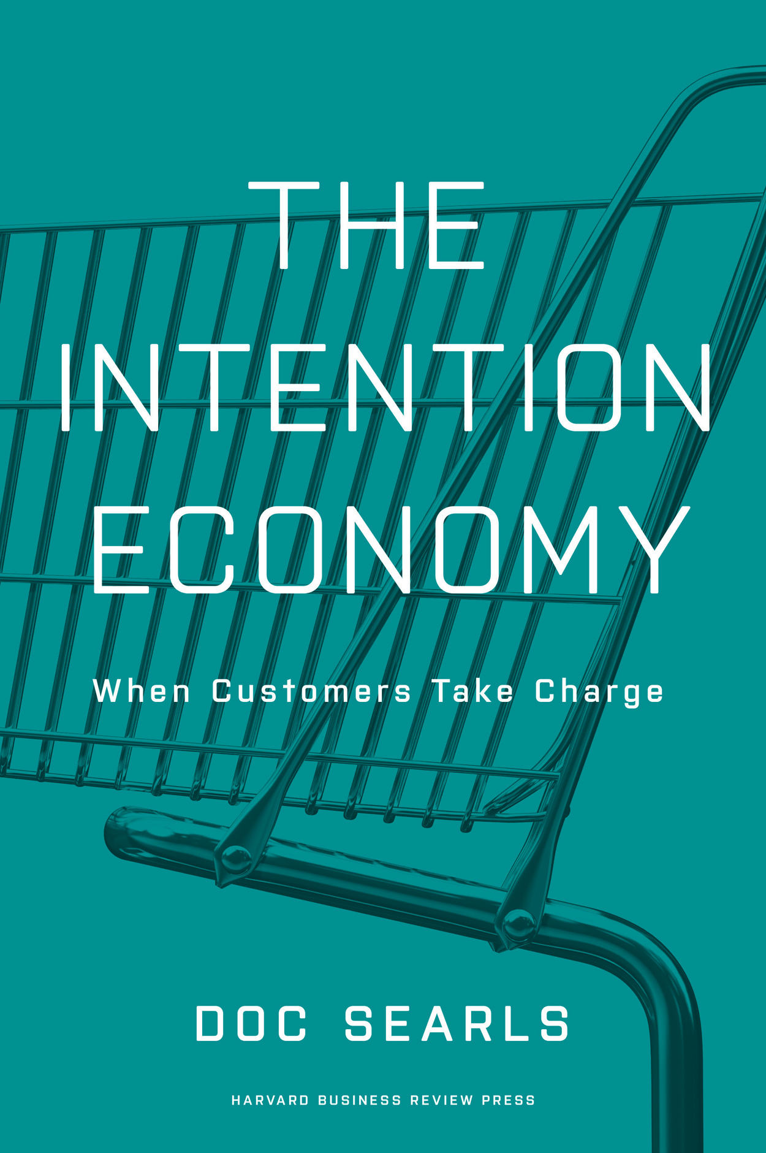
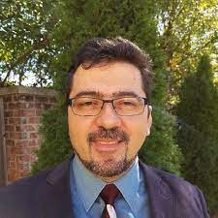
Hadrian Zbarcea

Slide 12
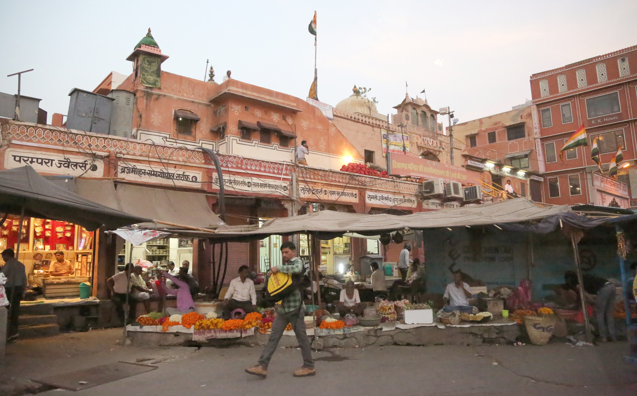
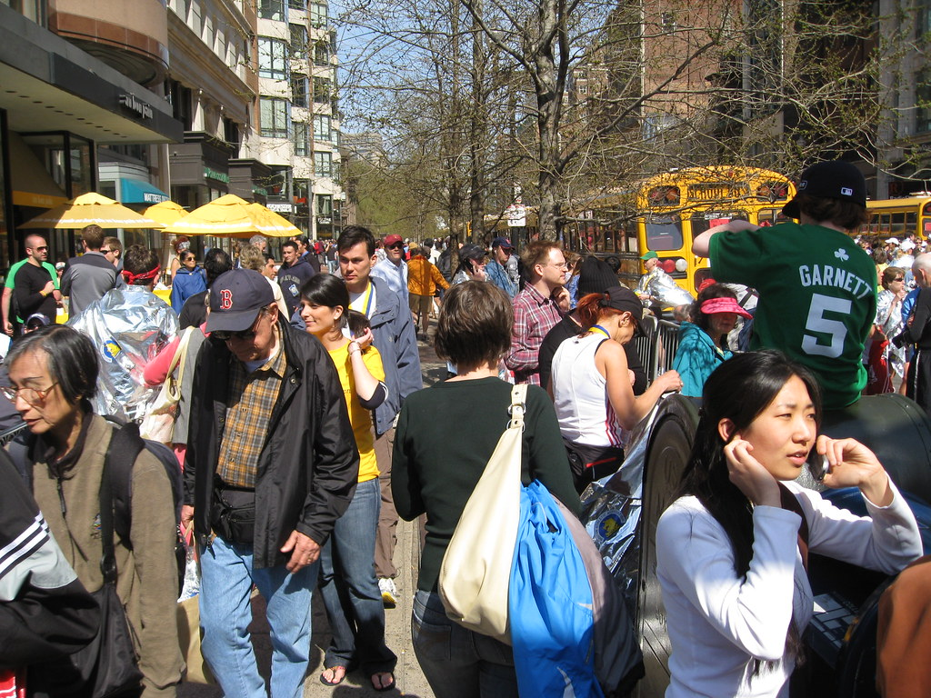
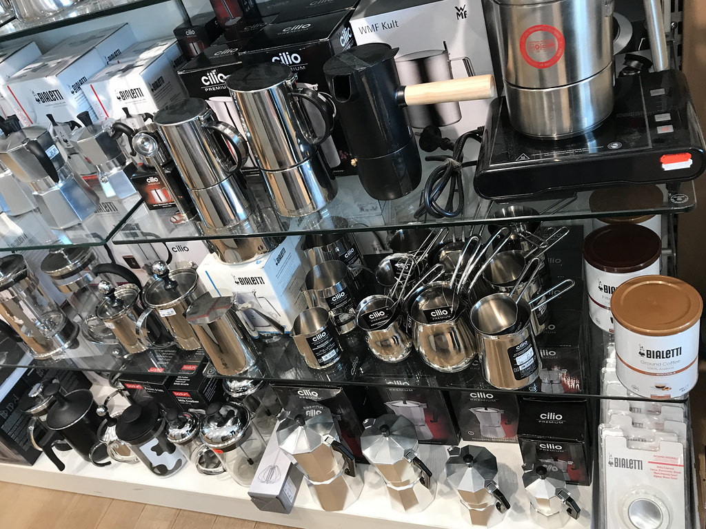
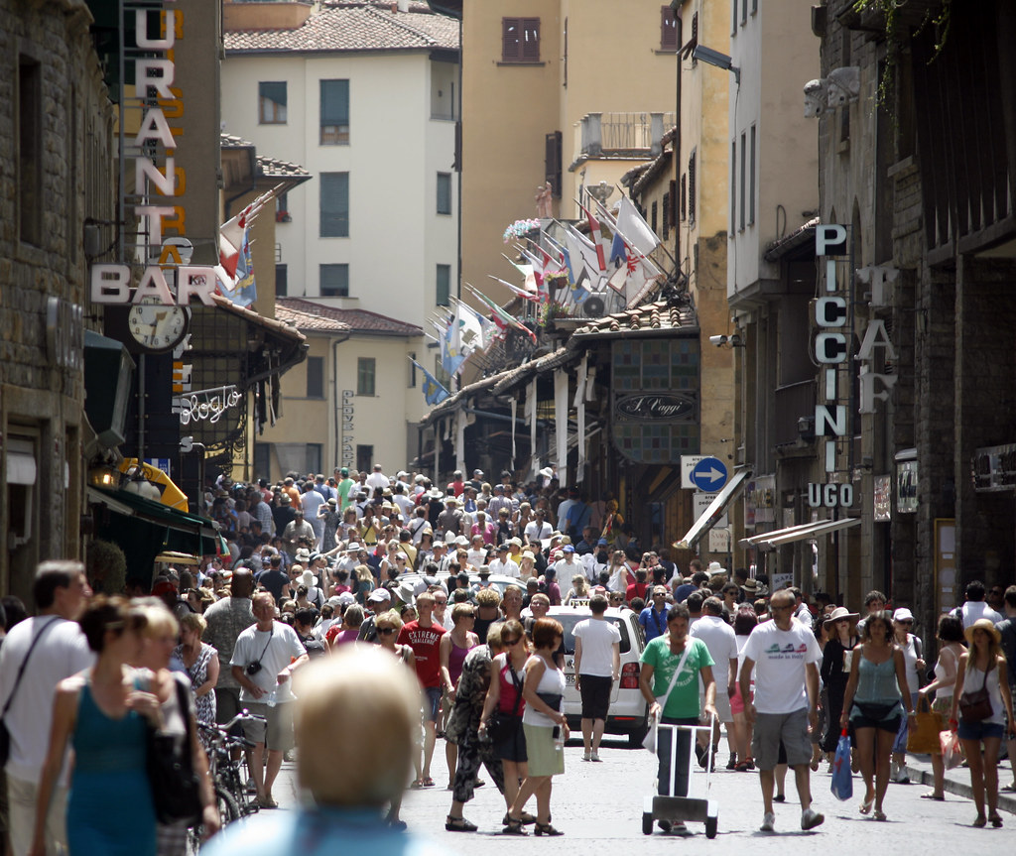
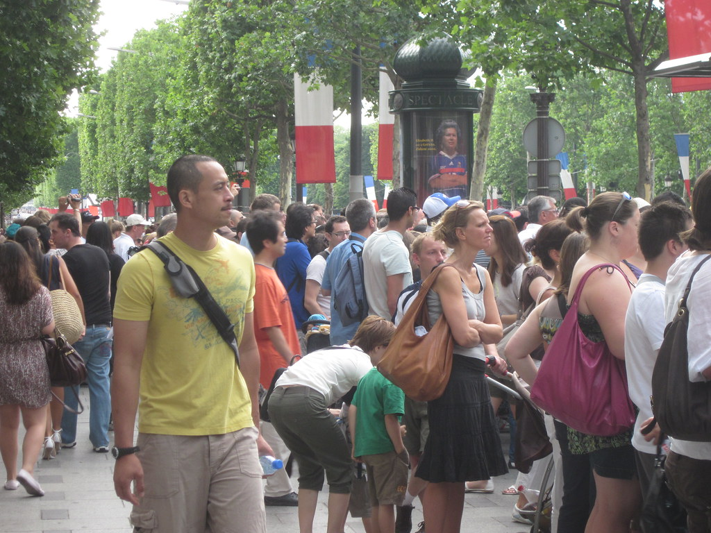
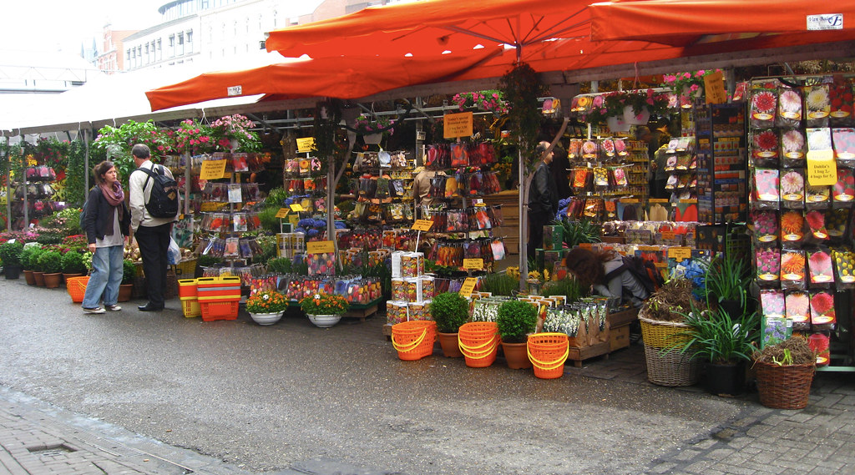
The Byway marketplace is for everyone & everything
The Street

Slide 13
On the Byway, buyers say what they are looking for

Slide 14
and sellers hear only what buyers are interested in

Slide 15
Where do we start?
Food?
Cars and parts?
Collectables?
Gigs?

Slide 16
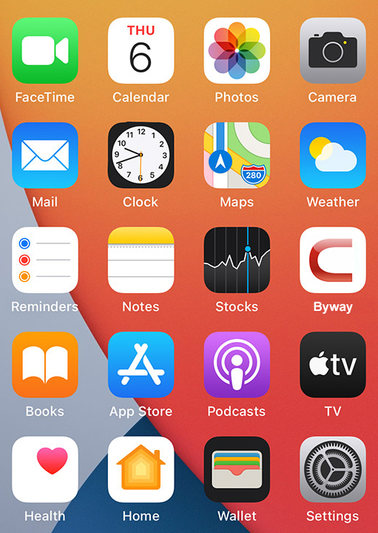
On the Byway, buyers and sellers have homes on the Net
Private compute nodes
Can be physical or virtual
Run apps from independent sources
Run palgorithms on their own data
Do most of the Byway’s work

Slide 17
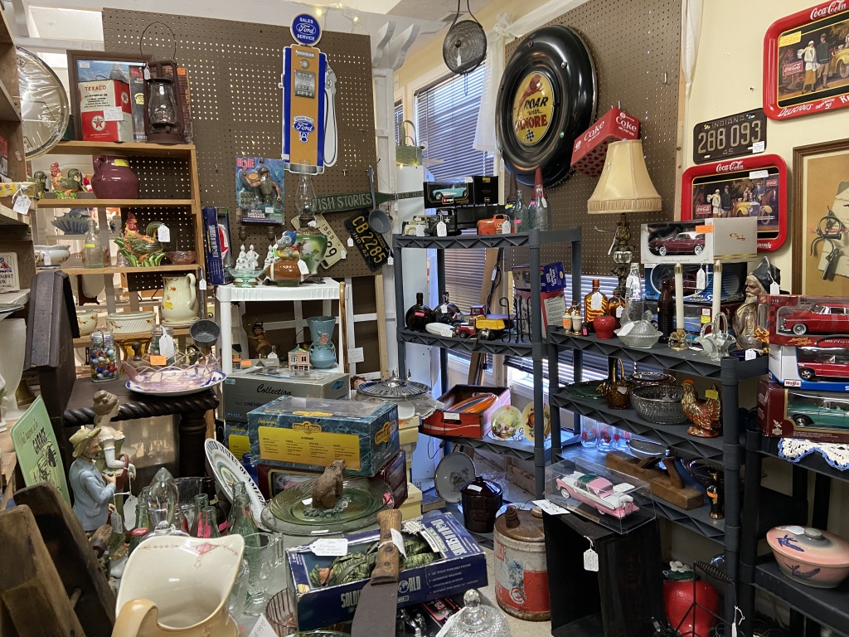
From the buyer’s view:
Publish
Subscribe
#bentwood #chair [1-off-return address]
Addressing authority
#
#
# #
#
#
#
#bentwood
#chair
Cathy Customer
Messaging service
Carl’s Collectables
I have a bentwood chair

Slide 18
From the seller’s view:
publishers
subscriber
# # # # # # # # # # # Inventory # # # # # # # # # #
# # # # # # # # # # # # # # # # # # # # # # # # # # # # # # # # # # # # # # # # # # # # # # # # # # # # # #
# # # # # # # # # # # # # # # # # # # # # # # # # # # # # # # # # # # # # # # # # # # # # # # # # # # # # # # # # # # # # # # # # # # # # # # # # # # # # # # # # # # # # # # # # # # # # # # # # # # # # # # # # # # #
# # # # # # # # # # # # # # # # # # # # # # # # # # # # # # # # # # # # # # # # # # # # # # # # # # # # # #
Addressing authority
Messaging service
Carl’s Collectables

Slide 19
What’s new here?
Home on the Net
Platform-free apps
Governance (with Ostrom help)
New business types and opportunities, starting with
Addressing authority
Message service
Reputation services
Online dispute resolution
New! Intentcasting
And more

Slide 20
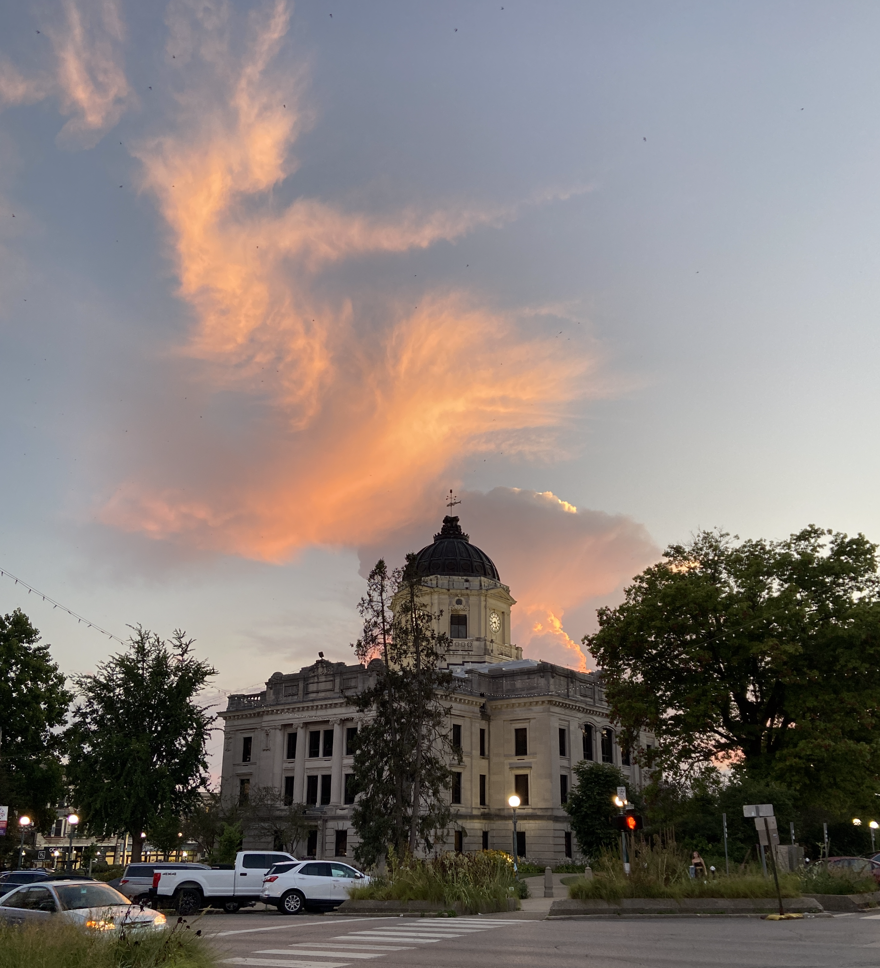
Why Bloomington:
“The sweet spot of the Internet is local”—JS
We’re here, at IU’s Ostrom Workshop
We have help developing and researching it
Bloomington is a real community, containing many real communities
It’s in the physical world
When it works, word will spread for good and right reasons

Slide 21
Help Wanted:
App developers
Use cases
Communities of interest
Marketers
Entrepreneurs

Slide 22
doc@searls.com
joyce@searls.com
CustomerCommons.org
OstromWorkshop.indiana.edu

